Slide 1
Java Web Development basis——From Servlet To JSP
First04 chapter Servlet Programming basics

Slide 2
learning target:
After studying in this chapter, you should:
Grasp HTTP Basic concept of communication protocol
To understanding Servlet Functions and uses
Master how to pass NetBeans IDE Correct Servlet Programming
Grasp ServletLife cycle
Grasp Servlet deal with HTTPRequest flow
Master how to obtain HTTP The content of the request header
Master how to set HTTPResponse header information
Master how to Servlet Chinese characters are displayed in the generated page
Master how to forward requests

Slide 3
4.1 HTTPBasic concept of communication protocol
Hypertext Transfer Protocol (HTTP)
HTTP is the most widely used network protocol on the Internet. All WWW All documents must comply with this standard. Design HTTPThe original purpose was to provide a way to publish and receive HTMLThe method of the page, the browser interacts with the server through this protocol.

Slide 4
HTTP Basic operation mode of the agreement
HTTP The agreement allows users to propose HTTP"request"(request), and then returned by the server according to the actual processing result HTTP"response"(response):
When the user WEB When the server sends a request,WEBThe server will open a new connection through this connection, the user can HTTP Request to WEBserver
whenWEBServer received HTTP When requesting, it will be parsed and processed, and the processing result will be packaged into HTTPresponse
At last,WEBThe server willHTTPThe response is sent to the user, as long as the user receives HTTPresponse,WEBThe server will close the connection, and the user's execution status will not be saved
Model diagram see next page

Slide 5
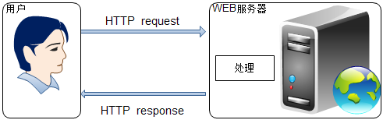
Figure4.1 HTTP Simplified model of protocol operation "request—deal with—response"

Slide 6
4.2 The role of Servlet
Servlet What is it? (Definition in Wikipedia)
ServletIs to use JavaThe server-side program written. The main function is to browse and modify data interactively, and generate dynamic Web content.
Narrowly Servlet Refers to an interface implemented by the Java .
Generalized Servlet Refers to any realization ServletClass of this interface(Generally refers to this).

Slide 7
Servlet Has the following effects
Read the explicit data (form data) sent by the client program
Read the implicit data sent by the client program (request header)
Process data and generate corresponding results
Send explicit data to the client program (text/html)
Send implicit data to the client program (status code and response header)

Slide 8
ServletIs running on the server side, byJavaProvided is a dynamic web technology used to process customer requests and generate response actions.

Slide 9
Client's request method get/post/?
For general customers, the action of making a request is relatively fixed, and there are several situations as follows:
Request a resource through the browser address bar
Click on a hyperlink on the page to request a resource
Submit information via the form (method="get/post")
The essence is only 2 Kind of request, namely getRequest and postRequest.
So in using Servlet When programming, mainly deal with these two kinds of requests.

Slide 10
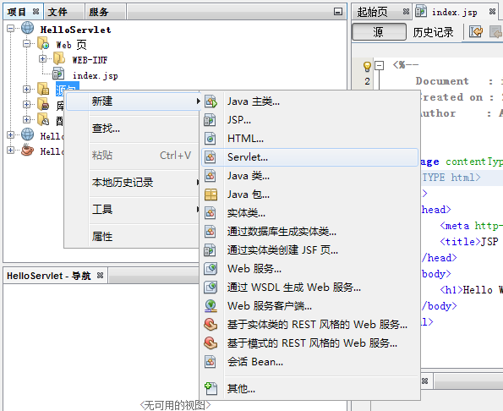
4.3 A simpleServletExample
Figure4.2 NewServlet

Slide 11
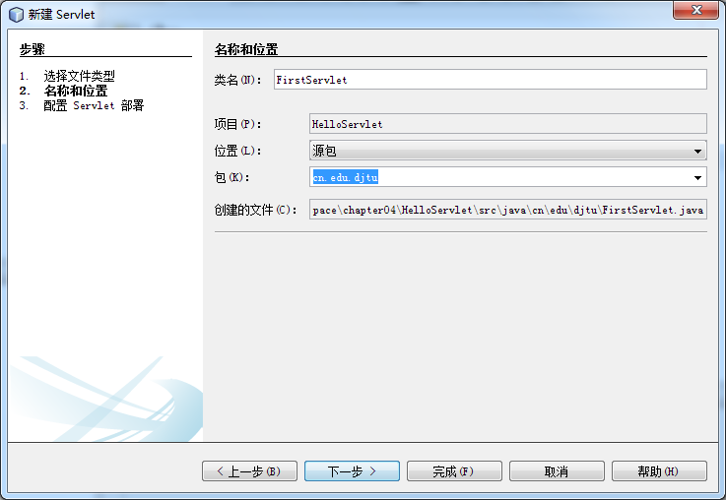
Figure4.3 Set name and location (class name and package name)

Slide 12
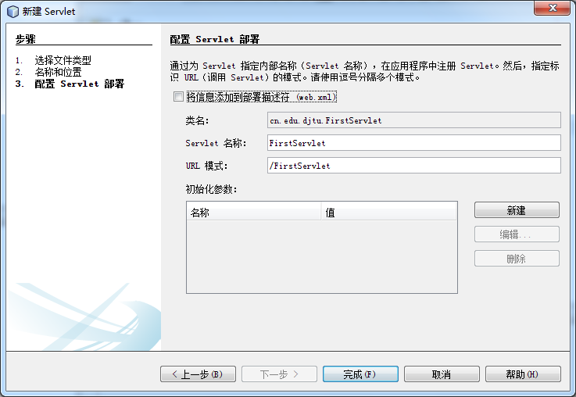
Figure4.4 ConfigurationServletDeployment (Servletname,URLmode)

Slide 13
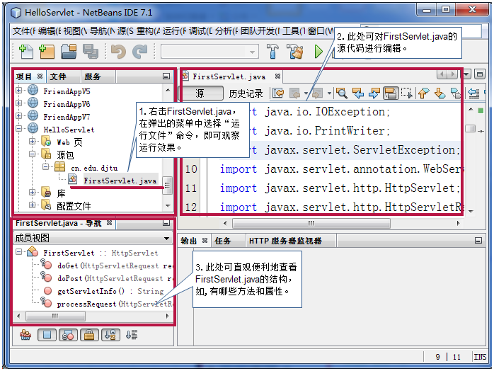
Figure4.5 NewFirstServletAfter effect picture

Slide 14
doGetMethod response to customer submissiongetRequest
protected void doGet(HttpServletRequest request, HttpServletResponse response)
throws ServletException, IOException {
processRequest(request, response);
}
doPostMethod response to customer submissionpostRequest
protected void doPost(HttpServletRequest request, HttpServletResponse response)
throws ServletException, IOException {
processRequest(request, response);
}

Slide 15
processRequestMethod (the default code is as follows)
protected void processRequest(HttpServletRequest request, HttpServletResponse response)
throws ServletException, IOException {
  response.setContentType("text/html;charset=UTF-8");
  PrintWriter out = response.getWriter();
  try {
    out.println("<html>");
    out.println("<head>");
    out.println("<title>Servlet FirstServlet</title>");
    out.println("</head>");
    out.println("<body>");
    out.println("<h1>Servlet FirstServlet at"+request.getContextPath()+"</h1>");
    out.println("</body>");
    out.println("</html>");
  } finally {out.close();}
}
set the encoding format to UTF-8
Made aPrintWriterType of object out

Slide 16
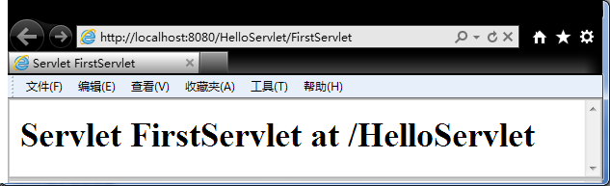
Figure4.7 FirstServletrunning result

Slide 17
4.4 Process the information explicitly submitted by the client
Obtain the data submitted by the client by using HttpServletRequestType of objectrequestTo operate.
request.getParameter You can get a single value submitted by the user (for example, a text box in a form, a field name corresponds to a value)
request.getParameterValues You can get multiple values ​​submitted by the user (for example, the check box in the formcheckbox, A field name, but may have multiple values).

Slide 18
HttpServletRequest Interface inherited from javax.servlet.ServletRequestinterface,javax.servlet.
ServletRequest Defines the following 2 Ways to read the content of the request.
Method name | Return value type | Applicable situation
getParameter(String name) | String | Get the parameter value of a request parameter, if the parameter has no value, return""; If the parameter does not exist, returnnull
request.getParameterValues(String name) | String[] | If a parameter may have multiple values, this method can be used to get all the values ​​at once and encapsulate them in oneStringIn the array; if the parameter does not exist, returnnull

Slide 19
4.4.1 Get a single value submitted by the user (getParameter)
Goal: learn to useServlet To process a single value submitted by the client
Construction name:Example0401
Files used:
file name | Description
index.jsp | Simply rewrite the files that are automatically created when the project is created. The page used by the customer to submit information includes a hyperlink, a form, and a text field and a submit button in the form.
ShowMsgServlet1 | Manually createdServlet, Used to obtain the information submitted by the user through the hyperlink, and display it in the form of a web page.
ShowMsgServlet2 | Manually createdServlet, Used to obtain the information submitted by the user through the form, and display it in the form of a web page.

Slide 20
index.jsp
<body>
<a href="ShowMsgServlet1?name=tom">
The parameter submitted through the hyperlink, the parameter name isname, The value istom
</a>
<form action="ShowMsgServlet2" method="POST">
What I want to say:<input type="text" name="msg" value="" />
<input type="submit" value="submit"/>
</form>
</body>

Slide 21
ShowMsgServlet1.java
protected void processRequest(HttpServletRequest request, HttpServletResponse response)
throws ServletException, IOException {
response.setContentType("text/html;charset=UTF-8");
PrintWriter out = response.getWriter();
try {
  String myname = request.getParameter("name");
  out.print(myname);
} finally {
  out.close();
}
}

Slide 22
ShowMsgServlet2.java
protected void processRequest(HttpServletRequest request, HttpServletResponse response)
throws ServletException, IOException {
response.setContentType("text/html;charset=UTF-8");
PrintWriter out = response.getWriter();
try {
  String mymsg = request.getParameter("msg");
  out.print(mymsg);
} finally {
  out.close();
}
}

Slide 23
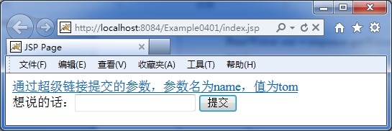
Run index.jsp,as the picture shows
index.jsp running result

Slide 24
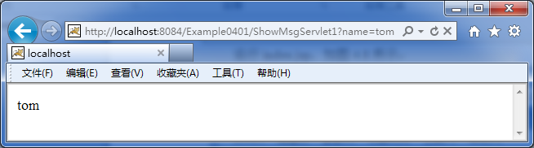
Click the hyperlink, the operation effect is as shown in the figure
(Pay attention to the browser address bar, the parameter name and parameter value are displayed in plain text)
Click on index.jsp Run effect after page hyperlink

Slide 25
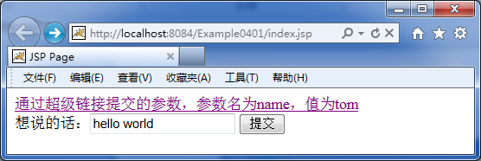
Back toindex.jspPage and enter information

Slide 26
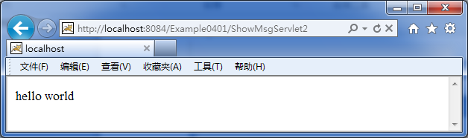
inindex.jsp After entering the information,
click the submit button to run the effect

Slide 27
Two in this example Servlet.
The core code logic in is the same
//Go to the parameter value by the parameter name and assign it to the variable
String mymsg = request.getParameter("msg");
//Output the value of the variable
out.print(mymsg);

Slide 28
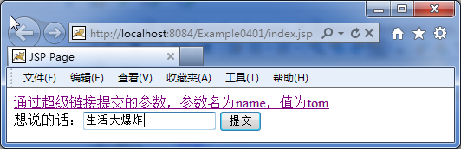
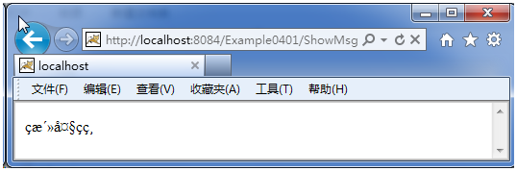
4.4.2 Chinese garbled processing
If inExample0401Submit after entering Chinese in the words you want to say
the information cannot be displayed correctly, and garbled characters appear

Slide 29
Processing method
Set the encoding format of the request object to"UTF-8", The statement is as follows:
request.setCharacterEncoding("UTF-8");
It is the same as the character set set by the response object.
response.setContentType("text/html;charset=UTF-8");
It is also consistent with the encoding format set on the page
<%@page contentType="text/html" pageEncoding="UTF-8"%>
<meta http-equiv="Content-Type" content="text/html; charset=UTF-8">

Slide 30
protected void processRequest(HttpServletRequest request, HttpServletResponse response)
throws ServletException, IOException {
  request.setCharacterEncoding("UTF-8");
  response.setContentType("text/html;charset=UTF-8");
  PrintWriter out = response.getWriter();
  try {
    String mymsg = request.getParameter("msg");
    out.print(mymsg);
  } finally {
    out.close();
    }
}

Slide 31
4.4.3 Get multiple values ​​submitted by users (getParameterValues)
Goal: useServletTo handle multiple values ​​submitted by the client
Construction name:Example0402
Files used:
file name | Description
index.jsp | Simply rewrite the files that are automatically created when the project is created. The page used by the customer to submit information includes a form with multiple check buttons and a submit button.
ShowMsgServlet | Manually createdServlet, Used to obtain the information submitted by the user through the form, and display it in the form of a web page.

Slide 32
index.jsp
<body>
<form method="POST" action="ShowMsgServlet">
  Your favorite mobile phone brand:
  <input type="checkbox" name="cellphone" value="nokia" />nokia
  <input type="checkbox" name="cellphone" value="htc" />htc
  <input type="checkbox" name="cellphone" value="apple" />apple
  <input type="submit" value="submit"/>
</form>
</body>

Slide 33
ShowMsgServlet.java
protected void processRequest(HttpServletRequest request, HttpServletResponse response)
throws ServletException, IOException {
response.setContentType("text/html;charset=UTF-8");
PrintWriter out = response.getWriter();
try {
  String[] phones=request.getParameterValues("cellphone");
  for (String phonename: phones) {
  out.print(phonename);
  }
} finally {
out.close();
}
}

Slide 34
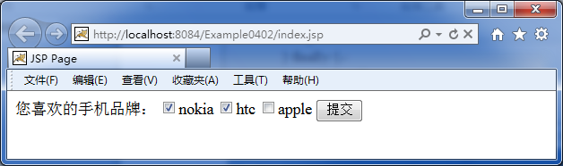
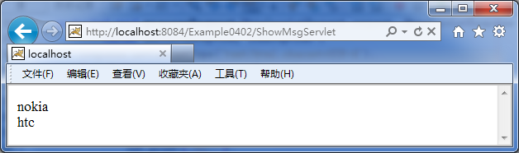
runindex.jsp, After select several mobile phone brands, Submit.
The running effect after submission is shown in the figure

Slide 35
4.5 Processing information implicitly submitted by the client
What is implicitly submitted information?
This part of information can be obtained by the server. Generally, data operations are not performed on it, mainlyRequest header information.
How to obtain the information submitted implicitly?
The information obtained in the request header is still used HttpServletRequest Type of object

Slide 36
HttpServletRequestCommon methods of types of objects
Method name | Return value type | Applicable situation
getHeader(String name) | String | Get the information of a specific request header, the return value is a string
getHeaderNames() | Enumeration | GetHTTPThe information of all request headers in the request, the return value is an object of enumeration type

Slide 37
Goal: learn to useServlet,
Processing the request header information submitted by the client
Construction name:Example0403
Files used:
file name | Description
ShowHeadServlet | Manually createdServlet, Used to obtain the request header information submitted by the user, and display it in the form of a web page.

Slide 38
ShowHeadServlet.java
protected void processRequest(HttpServletRequest request, HttpServletResponse response)
throws ServletException, IOException {
response.setContentType("text/html;charset=UTF-8");
PrintWriter out = response.getWriter();
try {
  Enumeration allHeaderName = request.getHeaderNames();
  out.print("<table>");
  while (allHeaderName.hasMoreElements()) {
  String headerName = (String) allHeaderName.nextElement();
  String headerValue = request.getHeader(headerName);
    out.print("<tr>");
      out.print("<td>" + headerName + "</td>");
      out.print("<td>" + headerValue + "</td>");
    out.print("</tr>");
  }
  out.print("</table>");
} finally {out.close();}
}

Slide 39
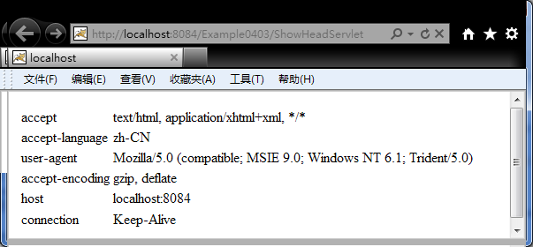
The running effect is shown in the figure4.17.

Slide 40
4.6 Redirection of response and forwarding of request
In practical applications, obtaining customer information is only the first step, and often based on the input information,Locate the customer’s request to other resources (Servlet Or webpage).
How to solve this problem?
Then you need to use
Response redirection or Request forwarding.

Slide 41
4.6.1 Response redirection
Redirecting to a resource is equivalent to resending a HTTPrequest by HttpServletResponseType object sendRedirect
Method name | sendRedirect(String location)
Return value type | void
Applicable situation | Redirect users to other pages or websites. iflocationNot with "/"At the beginning, the container resolves to be relative to the currentURI. iflocationWith "/"At the beginning, the container considers relative to the currentServletThe root directory of the container. If the response has been submitted, calling this method will throwIllegalStateExceptionType of exception

Slide 42
Goal: useHttpServletResponse to implement response redirection
Construction name:Example0404
Files used:
file name | Description
login.jsp | The manually created page contains a form with text boxes for entering the user name, password boxes for entering the password, and a submit button for submitting login information.
error.jsp | Manually created page, the page displays "Username or password is wrong, please re-enter!"
HandleLoginServlet | Manually created Servlet, Used to obtain the login information submitted by the user, if the user name isadminThe password is1234Then output "Welcome!", otherwise redirect toerror.jsp.

Slide 43
login.jsp
<body>
<h1>User login</h1>
<form method="POST" action="HandleLoginServlet">
  username:<input type="text" name="username" value="" /><br/>
  password:<input type="password" name="userpass" value="" /><br/>
  <input type="submit" value="log in"/>
</form>
</body>

Slide 44
error.jsp
<body>
<h1>Username or password is wrong, please re-enter!</h1>
</body>

Slide 45
HandleLoginServlet.java
protected void processRequest(HttpServletRequest request, HttpServletResponse response)
throws ServletException, IOException {
  request.setCharacterEncoding("UTF-8");
  response.setContentType("text/html;charset=UTF-8");
  PrintWriter out = response.getWriter();
try {
  String username=request.getParameter("username");
  String userpass=request.getParameter("userpass");
  if ("admin".equalsIgnoreCase(username)&&"1234".equals(userpass)) {
      out.print("welcome");
  } else {
    response.sendRedirect("error.jsp");
  }
} finally {out.close();}}

Slide 46
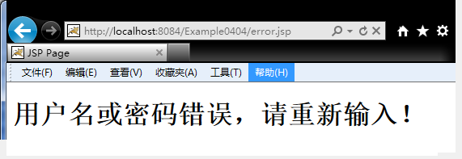
When the user name and password are entered incorrectly, the effect is shown in the figure4.18
As shown, pay attention to the address bar, you can see that the user islogin.jsp After entering the login information, go throughServlet Dealt with and was redirected toerror.jsp.

Slide 47
4.6.2 Request forwarding
The redirection of the response can achieve the effect of jumping from one resource to another resource. In addition to it, the forwarding of the request can also jump between resources.
By HttpServletRequest Interface getRequestDispatcher Object.
by RequestDispatcher The corresponding method of the object can realize the forwarding of the request.
Get transponderRequestDispatcher Statement of the object (forwarded here toindex.jsp)
RequestDispatcher rd=request.getRequestDispatcher("index.jsp");

Slide 48
RequestDispatcher Object forwarding request method
method1 forward(ServletRequest request, ServletResponse response)
method2 include(ServletRequest request, ServletResponse response)
Method name | Return value type | Applicable situation
forward(ServletRequest request, ServletResponse response) | void | Change the request from aServletForward to other on the serverServlet,JSPorHTML
include(ServletRequest request, ServletResponse response) | void | Include the content of other resources in the response (e.g.Servlet,JSPorHTML)
include() and forward() method is very similar, the only difference is: use include()Method forwarding to others Servlet After being called Servlet Although it can handle this HTTPRequest, but the final dominance is still in the originalServlet. In other words, the called Servlet If any HTTPResponse will be merged into the original HttpResponseObject.

Slide 49
Improved user login example demonstrates the forwarding of requests
Goal: useRequestDispatcherto realize the forwarding of the request
Construction name:Example0405
Files used:
file name | Description
login.jsp | The manually created page contains a form with text boxes for entering the user name, password boxes for entering the password, and a submit button for submitting login information.
index.jsp | Simply rewrite the file automatically created when the project is created, and display "Welcome!".
HandleLoginServlet | Manually createdServlet, Used to obtain the login information submitted by the user, if the user name isadminThe password is1234Then forward toindex.jsp, Otherwise output "Username or password is wrong, please re-enter!" and display the login page (login.jsp)content.

Slide 50
login.jsp
<body>
<h1>User login</h1>
<form method="POST" action="HandleLoginServlet">
  username:<input type="text" name="username" value="" /><br/>
  password:<input type="password" name="userpass" value="" /><br/>
  <input type="submit" value="log in"/>
</form>
</body>

Slide 51
index.jsp
<body>
  <h1>welcome!</h1>
</body>

Slide 52
HandleLoginServlet.java
protected void processRequest(HttpServletRequest request, HttpServletResponse response)
throws ServletException, IOException {
  request.setCharacterEncoding("UTF-8");
  response.setContentType("text/html;charset=UTF-8");
  PrintWriter out = response.getWriter();
try {
  String username = request.getParameter("username");
  String userpass = request.getParameter("userpass");
  if ("admin".equalsIgnoreCase(username) && "1234".equals(userpass)) {
    RequestDispatcher rd=request.getRequestDispatcher("index.jsp");
    rd.forward(request, response);
  } else {
    out.print("Username or password is wrong, please re-enter!");
    RequestDispatcher rd=request.getRequestDispatcher("login.jsp");
    rd.include(request, response);
  }
} finally {out.close();}}

Slide 53
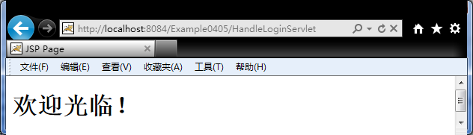
When the user name and password are entered correctly, the effect is shown in the figure. Pay attention to the address bar, you can see that the user is inlogin.jsp After entering the correct login information, inServletDuring processing, the request was forwarded to index.jsp(Because it shows index.jsp Content), but the address bar hasn’t changed, it’s still right HandleLoginServlet Requests made.
Operation effect when the username and password are entered correctly

Slide 54
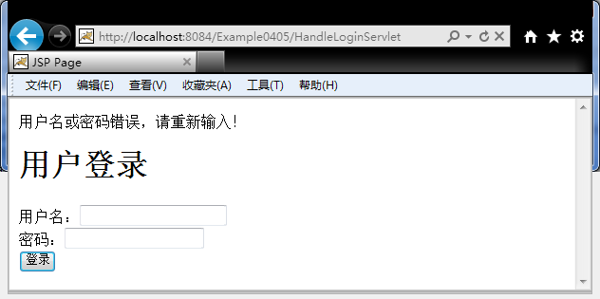
When the user name and password are entered incorrectly, the effect is shown in the figure. Pay attention to the address bar, you can see that the user is inlogin.jsp After entering the login information, inServlet During processing, the request was forwarded to login.jsp).
Run effect when user name and password are entered incorrectly

Slide 55
4.6.3 Comparison of response redirection and request forwarding
Both response redirection and request forwarding can achieve jumps between resources, but there is still a big difference between the two.
E.g: How does the emergency center 120 receive the alarm and deal with it?
in conclusion:
Response redirection Yes Two requests
Request forwarding Yes One request

Slide 56
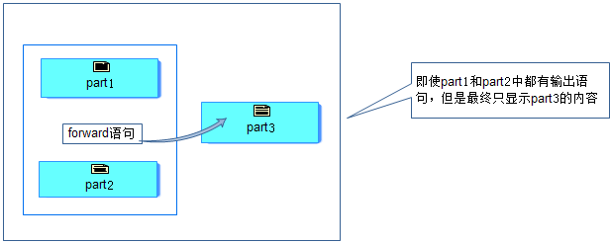
4.6.4 Request forwarding forward Method and include Comparison
forwardSchematic diagram of method operation
Conclusion: control belongs to the target component

Slide 57
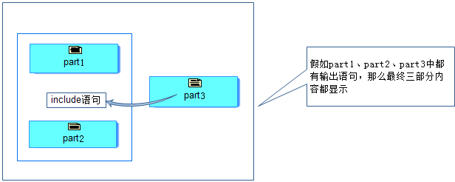
includeSchematic diagram of method operation
Conclusion: control back to the source component

Slide 58
HandleLoginServlet(Add part of the code for comparison test)
protected void processRequest(HttpServletRequest request, HttpServletResponse response)
throws ServletException, IOException {
response.setContentType("text/html;charset=UTF-8");
PrintWriter out = response.getWriter();
try {
  String username = request.getParameter("username");
  String userpass = request.getParameter("userpass");
  if ("admin".equalsIgnoreCase(username) && "1234".equalsIgnoreCase(userpass)) {
    RequestDispatcher rd=request.getRequestDispatcher("index.jsp");
    out.print("Before forward");
    rd.forward(request, response);
    out.print("After forward");
  } else {
    out.print("Username or password is wrong, please re-enter!");
    RequestDispatcher rd=request.getRequestDispatcher("login.jsp");
    out.print("Before include");
    rd.include(request, response);
    out.print("After include");
}} finally {out.close();}

Slide 59
4.7 Servlet Advanced
Servlet There is no main method, and we have never used it new someServlet() Such code to instantiate an object, then:
Servlet Who instantiates, initializes, uses, and destroys objects?
How to find the container Servlet of?

Slide 60
4.7.1 ServletLife cycle
ServletIs a component running on the server side is instantiated, initialized, used, and destroyed by Servlet container.Whenever a user ServletWhen a request is made, the container instantiates an object, and then starts a thread to serve the user, when another user requests the same Servlet When we start another thread to provide services.
Servlet:"Single instance, multi-threaded".

Slide 61
Servlet API The hierarchical relationship is FirstServlet.java As an example
FirstServlet Inherited from HttpServlet
@WebServlet(name = "FirstServlet", urlPatterns = {"/FirstServlet"})
public class FirstServlet extends HttpServlet {//Code slightly}
HttpServlet Inherited from GenericServlet
public abstract class HttpServlet extends GenericServlet {//Code slightly}
GenericServlet Three interfaces are implementedServlet, ServletConfig, Serializable
public abstract class GenericServlet implements Servlet, ServletConfig, Serializable {//Code slightly}

Slide 62
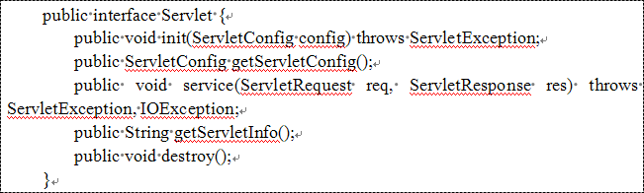
Servlet Methods defined in the interface

Slide 63
Servlet The life cycle and the method to call
The life cycle is divided into three parts:Initialization, external service, destruction.
initializationWhen the call is init() method, this method only works inServletIt is executed once when it is loaded for the first time and it is not called for every request.
Provide external servicesWhen the call is service() method, this method is called by the server for each request in a new thread, but usually this method is not directly programmed but the corresponding method is called for different request methodsdoXxx() method, such as the aforementioned doGet(),doPost() Wait.
destroyWhen called destroy() method, the method is deleted on the serverservletWhen the instance of the call. This method is not called after every request.

Slide 64
Deep understanding Servlet Life cycle
Goal: understandServletLife cycle
Construction name:Example0406
Steps: Create NewServlet.java ofServlet, All settings take default values.
Generate and write construction method NewServlet().
Overwrite init() method.
Overwrite service() method.
Overwrite destroy() method.
Write processRequest() method.

Slide 65
1, Generate and write the construction methodNewServlet()
public NewServlet() {
  System.out.println("Call constructor");
}
2, Overwriteinit()method
@Override
public void init() throws ServletException {
  System.out.println("transfer init method");
  super.init();
}

Slide 66
3, Overwriteservice()method
@Override
protected void service(HttpServletRequest req, HttpServletResponse resp) throws ServletException, IOException {
  System.out.println("transfer service method");
  super.service(req, resp);
}
4, Overwritedestroy() method
@Override
public void destroy() {
  System.out.println("transfer destroy method");
  super.destroy();
}

Slide 67
5,writeprocessRequest()method
protected void processRequest(HttpServletRequest request, HttpServletResponse response)throws ServletException, IOException {
  response.setContentType("text/html;charset=UTF-8");
  PrintWriter out = response.getWriter();
  try {
    System.out.println("transferprocessRequestmethod");
  } finally {
    out.close();
  }
}

Slide 68
NewServlet.java(Code after writing)
@WebServlet(name = "NewServlet", urlPatterns = {"/NewServlet"})
public class NewServlet extends HttpServlet {
public NewServlet() {System.out.println("Call constructor");}
@Override
public void init() throws ServletException {
  System.out.println("transferinitmethod");
  super.init();
}
@Override
protected void service(HttpServletRequest req, HttpServletResponse resp) throws ServletException, IOException {
  System.out.println("transferservicemethod");
  super.service(req, resp);
}
@Override
public void destroy() {
  System.out.println("transferdestroymethod");
  super.destroy();
}
protected void processRequest(HttpServletRequest request, HttpServletResponse response)throws ServletException, IOException {
  response.setContentType("text/html;charset=UTF-8");
  PrintWriter out = response.getWriter();
  try {
    System.out.println("transferprocessRequestmethod");
  } finally {
    out.close();
  }
}
//OmitteddoGet,doPost,getServletInfoThree methods of code
//becausedoGet,doPostBoth callprocessRequestmethod
}

Slide 69
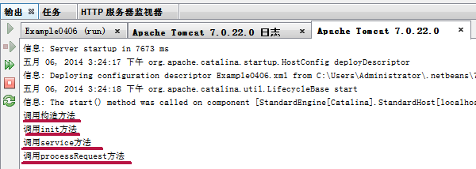
Run this Servlet, Observe the output of the output window
The constructor is called first, and then the initialization method is calledinit, And then call the service methodservice,service Method is called again processRequestMethod, but I don’t see the "Calldestroy“ Method", stating ServletThe object has not been destroyed yet.
First1Visits, implementation of each method

Slide 70
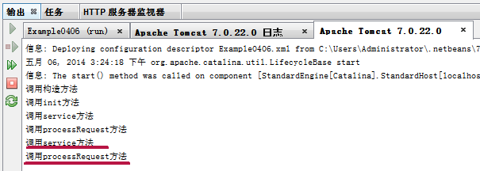
Open another browser window and copy theurl "Http://localhost:8084/Example0406/NewServlet"Copy and paste it into the address bar to simulate another user's visit. The results of the operation are shown in the figure:
Called againserviceMethods andprocessRequestMethod, without calling the constructor and initialization methodinit. This shows that only one was createdServletObject. This proves what I said beforeServletIt is "single instance, multithreaded".

Slide 71
Will service In the method super.service(req, resp);The statement is commented out.
@Override
protected void service(HttpServletRequest req, HttpServletResponse resp) throws ServletException, IOException {
  System.out.println("transferservicemethod");
  //super.service(req, resp);
}

Slide 72
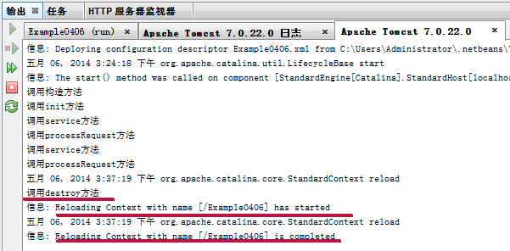
Since the code has changed,Tomcat Re-deploy the hot deployment. At this time, the currentServlet The object needs to be destroyed, so the console can see the "calldestroyMethod", which means that the destroymethod.

Slide 73
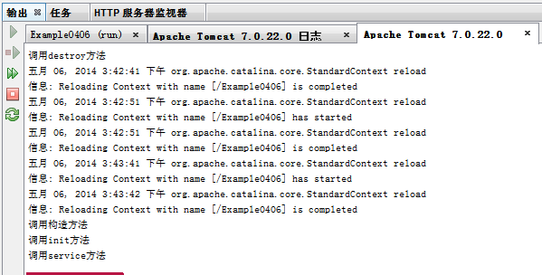
At this point, run againNewServletAt this time, the server will restart and redeploy, which means it will re-instantiate the object, initialize the object, provide services to the outside, and wait for destruction. Maybe everyone will feel the same as the last time, but please see the operation, as shown in the figure .
The constructor is called, the initialization method is called init, Called service method. However, there is no call processRequest method. Why, because we commented out this statement.//super.service(req, resp);
In the method of the parent class,serviceThe method will be automatically called according to the type of requestdoXxxMethod, and after commenting out the statement, overwrite theserviceMethod will not automatically call the corresponding doXxxMethod, of course processRequest The method has no chance of execution.

Slide 74
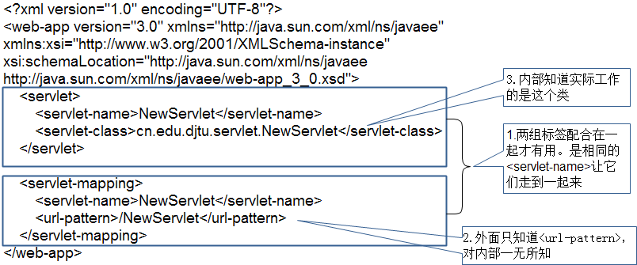
4.7.2 Servlet Deployment
In earlier versions, deployment was required web.xmlThis deployment descriptor. As shown in the figure, a total of two sets of markers are required
<servlet> </servlet>,<servlet-mapping> </servlet-mapping>.

Slide 75
For further understandingServlet For the deployment of, do the following attempts for comparison:
1.will<url-pattern>/NewServlet</url-pattern>To
<url-pattern>/test.html</url-pattern>And then run index.jspPage, in the address bar of the browser that runs outindex.jspChange to test.html, You will find that the actual visit isNewServlet.
2.Put two<servlet-name>NewServlet</servlet-name>All changed to
<servlet-name>test</servlet-name>And then runNewServlet, Can still run, indicating that the value of this place can also be configured separately.
From the perspective of maintenance, we usually take the default values ​​and do not make revisions. When there are special needs, we will set a certain value individually.ServletOn the line.

Slide 76
Use Annotation(Notes) Deployment Servlet
In the newServletIn the specification, it has been recommended to use Anotation(Notes), not the configuration file to completeServletThe deployment worked. The form is as follows:
@WebServlet(name = "NewServlet", urlPatterns = {"/NewServlet"})
public class NewServlet extends HttpServlet {
  //Code slightly
}
As you can see,name = "NewServlet“ The effect is equivalent to<servlet-name>NewServlet</servlet-name>；
urlPatterns = {"/NewServlet"}The effect is equivalent to
<url-pattern>/NewServlet</url-pattern>.

Slide 77
Homework problems
[1].Complete all the examples in this chapter independently.
[2].Compare the difference between the redirection of the response and the forwarding of the request.
[3].carry out4.6.4The exercise mentioned in the subsection, through this exercise, familiarize yourself with the request forwardingforwardMethod andincludeThe method is different.
[4].Try it, if the requested forwarder is not forwarding the request toJSPPage, but forwarded to aServlet. E.grequest.getRequestDispatcher("SomeServlet"), Then please observe the difference between the results and think about why?

